Slide 1
英语国家社会与文化入门》 (上册）
The Society and Culture
of Major English-Speaking Countries
An Introduction
(Book One)

Slide 2
Australia Unit 19 Australia in the World Today

Slide 3
Quiz
Give the English and a brief explanation for the following:
1 全球化
2 资本流动
3 反恐
4 温室气体
5气候变化

Slide 4
Focal Points
three stages in Australian foreign relations
economic relations
education in Australia
tourism in Australia
media in Australia
environmental risks
impact of climate change on Australia

Slide 5
This Unit Is Divided into Six Sections
Australia: Foreign Relations
Economic Relations
Education: Global Flows of Capital and People
Tourism in Australia: Global Flows of Capital, People and Culture
The Australian Media: Flows of Capital, Culture and Technology
Globalisation and Environmental Risks: Flows of Pollution

Slide 6
I. Australia: Foreign Relations
There are three major historical stages in Australia’s relationship with the rest of the world. Each of these stages has a common theme: Australia’s need to find both security and its own active role in the Asia Pacific region. This concern has taken different directions in these three. (Right: Asia-Pacific marked in green)

Slide 7
I. Australia: Foreign Relations
Stage One: 1788-1940s
Until 1900 Australia comprised a group of six British colonies whose relationship to the rest of the world was dictated by the British government.
On Federation in 1901, Australia became an independent colony but until the 1940’s it had little control in the field of foreign affairs.
In 1907 it was decided that the “great colonies” including Australia should no longer be called colonies but should be styled “the self-governing dominions beyond the seas”

Slide 8
I. Australia: Foreign Relations
Stage One: 1788-1940s
During WWII, the Australian government was horrified at the British neglect of the dangers that Japanese militarism posed to Australia. The government turned from the UK to the USA to cooperate in defending Australia.
The Statute of Westminster Adoption Act, passed by the Curtin Government in 1942, provided that in future the British Government could only legislate for Australia at Australia’s specific request.
It was a major step forward in Australia’s preparedness to forge its own legal identity in the world.

Slide 9
I. Australia: Foreign Relations
Australian Posters in WWII

Slide 10
I. Australia: Foreign Relations
Stage Two: 1940s -1970s
The danger during this period was that Australia had simply exchanged domination by the UK for domination by the USA.
The post-war successes of communism in Russia and China bred paranoia in the West. Australia was positioned as the “West’s outpost” in the Asia Pacific.
The ANZUS treaty was signed by Australia, New Zealand and the United States in 1951. From the 1950s to the 1970s Australia became involved in the American “crusade against communism” in the Korean War and the Vietnam War.
Meanwhile, the unpopular policy of conscription-by-ballot became one of the major factors leading to a negative reaction to Australia’s relationship with the USA.

Slide 11
I. Australia: Foreign Relations
17,000 Australians served in the Korean War between 1950 and 1953, and they suffered 339 dead, and 1200 wounded.
Australia's involvement in the Vietnam War, beginning with a small commitment of 30 military advisors in 1962, increased to 7,672 Australian personnel.

Slide 12
I. Australia: Foreign Relations
Stage Three: 1970s to date, Australia in the world today
The Whitlam Labor government (1972-1974) made a decision that Australia would take a more independent position.
It abolished conscription, withdrew troops from Vietnam in 1972, and in the longer term, moved to increase trade relations with Asia, most notably in order to have a more open political and trading relationship with China.
It officially recognised the People’s Republic of China. After Whitlam, relations with China and with the whole Asia Pacific region have continued to evolve.

Slide 13
I. Australia: Foreign Relations
Today, Australia is a member of the APEC, G20, OECD and WTO organisations.
APEC was established from an Australian initiative in 1989, when Canberra hosted the first informal dialogue with 12 members.
Since then the forum has grown to include 21 member economies and has become one of significant world economic bodies.
Australia takes its turn, along with other member nations, to host assemblies to promote regional stability and to address global issues including counter-terrorism, non-proliferation and health.
APEC Member Economies account for approximately 70 per cent of Australia’s trade and include eight of its top 10 export markets.

Slide 14
I. Australia: Foreign Relations
Chinese leader Hu Jintao attending APEC 2007 in Sydney.

Slide 15
II. Economic Relations
Globalisation: Flows of Capital
Australia’s capital investment in its own manufacturing industries declined significantly in the late twentieth century.
Capital investment in these industries shifted globally to cheaper labour markets in Asia.
The Australian economy now depends primarily upon its other two major sectors, the resources and services industries: the Australian service sector now represents 68% of Australian GDP.
However, the agricultural and mining sectors (representing only 10% of GDP combined) account for 57% of the nation’s exports.

Slide 16
II. Economic Relations

Slide 17
II. Economic Relations
The Resources Industry: Flows of Capital, Culture and
People
According to statistics, in 2007 Australia imported AU $228 billion of goods and services and exported AU $216 billion.
Australia’s main export partners are China, Japan, South Korea, the USA and India, and the main import partners are the USA, China, Japan, Singapore, and Germany.
In 1972, Japan became Australia’s largest trading partner. Then, in 2007, China overtook Japan.
Australia is a major exporter of natural gas, coal, iron, bauxite, copper, tin, gold, silver, uranium, tungsten, mineral sands, lead, zinc, opals, diamonds, grain, wool, meat and food products.

Slide 18
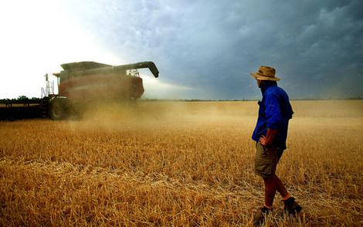
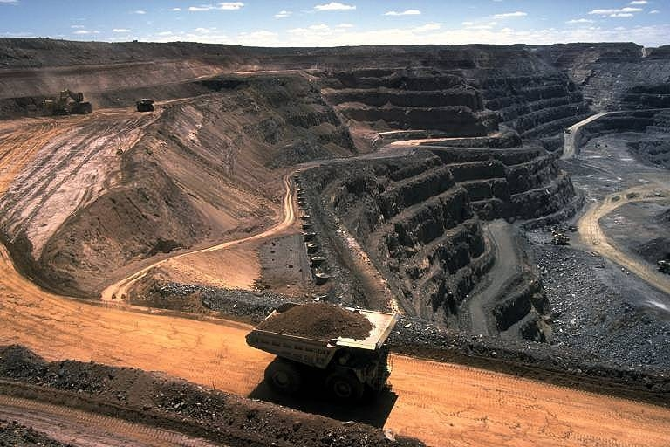
Beef industry
Australian opal
Wheat harvesting in Australia
Coal mining

Slide 19
II. Economic Relations
China is Australia’s biggest trading partner thanks mainly to its strong demand for iron ore, coal and liquefied natural gas.

Slide 20
III. Education: Global Flows of Capital and People
According to AEI, (Australian Education International) education services attract annual earnings of $15.5 billion and remains Australia’s third largest export, behind coal and iron ore and the largest services export industry, ahead of tourism.
Education is a “mushrooming industry”: foreign-student numbers in Australia increased from 228,000 in 2002 to around 527,000 in 2013.
However, by 2010, this rapid expansion had created problems, and there was concern that the education industry had been harmed by institutions that cashed in on foreigners who used education as a pathway to immigration.

Slide 21
III. Education: Global Flows of Capital and People
There are over 150,000 Chinese students studying at Australian schools and universities.

Slide 22
IV. Tourism in Australia: Global Flows of Capital, People and Culture
Tourism is the second major service industry in the Australian export economy. In 2007, it brought approximately 12 billion dollars into Australia.
Visitors from China alone, contributed over $2 billion to this total.
Prior to the 2007 global financial downturn, over 10 million overseas tourists visited Australia every year: a figure equal to nearly half of the population of Australia.
The major goal of Tourism Australia is to increase international and domestic travelers’ intention to visit Australia.

Slide 23
IV. Tourism in Australia: Global Flows of Capital, People and Culture
The most successful tourist marketing campaign, the “Put another Shrimp on the Barbie” campaign. "Shrimp on the barbie" is an often-quoted phrase that originated in a series of television advertisements by the Australian Tourism Commission starring Paul Hogan from 1984 through to 1990.

Slide 24
IV. Tourism in Australia: Global Flows of Capital, People and Culture
For the majority of overseas visitors, the most popular tourist features include the Great Barrier Reef, Ulura, Kakadu and the key city attractions and beaches of Sydney, the Gold Coast, and the other metropolitan centres.
Ulura, the magnificent megalith set in the vast and beautiful desert centre of Australia.

Slide 25
IV. Tourism in Australia: Global Flows of Capital, People and Culture
Kakadu National Park, managed by the Aboriginal clans, covers 19,000 square kilometres comprising rainforest, wetlands with paperbark trees, pandanus, cycads and lotus lilies. The wildlife includes crocodiles, barramundi, and a variety of birds. The area contains 1,000 different plant species, and a quarter of all Australian freshwater fish species.

Slide 26
IV. Tourism in Australia: Global Flows of Capital, People and Culture
A number of Aboriginal clans still live within the Park as their people have done for over 40,000 years and tourists can visit, with their guidance, some of the largest concentrations of Aboriginal rock art in the world.

Slide 27
V. The Australian Media: Flows of Capital, Culture and Technology
Newspapers or “The Press”
Over fifty English language newspapers, and several non-English publications in 20-25 other languages, are published in Australia.
The mainstream press comprises one national newspaper, The Australian and State based newspapers, including The Sydney Morning Herald and The Age. These major newspapers are owned by media corporations.
There are non-English speaking papers providing information from “home”, such as Arab countries and China, for non-Anglo-Australians: news which is often lacking in the mainstream Australian media.

Slide 28
V. The Australian Media: Flows of Capital, Culture and Technology
TV and Radio
Unlike the press, the TV and radio programmes are provided by a mixture of government networks, private business companies and by small community groups.
The publicly owned channels include SBS which runs news, information and entertainment programmes from a wide range of other countries.
However, the programmes with the highest ratings are those owned by the private, profit-oriented media corporations.
There are non-news programmes, dramas, comedies or quiz shows coming from the English-speaking countries, USA and Britain.

Slide 29
VI. Globalisation and Environmental Risks: Flows of Pollution
Over the past few decades globalisation has altered the kinds of hazards that nations face.
A major example is the current threat of climate change.
Global flows of pollution are created by the overproduction of greenhouse gases. These pollution flows are produced mainly by the high and medium power nations but affect all nations.
Three aspects of climate change are related to Australia: the role that Australia has played in contributing to climate change; the impact of climate change on Australia; and the country’s political and technological attempts to redress the problem.

Slide 30
VI. Globalisation and Environmental Risks: Flows of Pollution
Australia’s Greenhouse Gas Emissions
Australia only accounts for around 1.5% of global greenhouse gas emissions, but its per capita emissions are more than four times the world average.
Australia’s relatively high per capita emissions can be attributed to factors such as the high usage of coal in electricity generation, the agricultural emissions from large numbers of sheep and cattle, and by land clearing.

Slide 31
VI. Globalisation and Environmental Risks: Flows of Pollution
One of the Australian greenhouse gas emissions is through the forest destruction. Australia has the sixth largest area of forest in the world with 4% of the worlds forests. In 1990, carbon dioxide emissions from forest clearing for agriculture totaled 156 million tonnes, which is some 27.3 5% of Australia’s net emissions. The rate of clearing then doubled. Land cleared in Australia in 1994 was equal to that which was cleared in the previous five years.

Slide 32
VI. Globalisation and Environmental Risks: Flows of Pollution
Impact of Climate Change on Australia: Droughts, Fires, Cyclones and Floods and Species Loss
Risks Australia faces from climate change: the intensity of the cycles of droughts, fires, cyclones and floods; reduced water supplies to households, reduced river flows affecting the health and breeding patterns of its bird, animal and fish species, and threats to the production of domestic food resources and to the agricultural and manufacturing industries; an increase of the risk of fiercer and more widespread bushfires threatening both households and farming regions; increased flooding, especially in the tropical northern regions; more loss of Australian species.

Slide 33
VI. Globalisation and Environmental Risks: Flows of Pollution
Technological and Political Responses
There are several community based programmes focused on saving specific species.
The Australian and Tasmanian Governments have introduced alternatives to the use of clear felling in old growth forests.
Major political changes in water management are taking place, including “government buy backs” of major sections of its river systems, water-recycling and desalination schemes and government support for household rainwater tanks.
Alternative forms of renewable energy, wind farms, solar panels, biofuels, geothermal, ocean power and biomass are replacing some of the unsustainable and carbon polluting forms of energy resources.

Slide 34
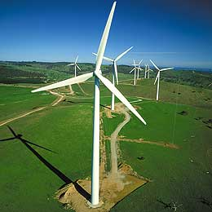
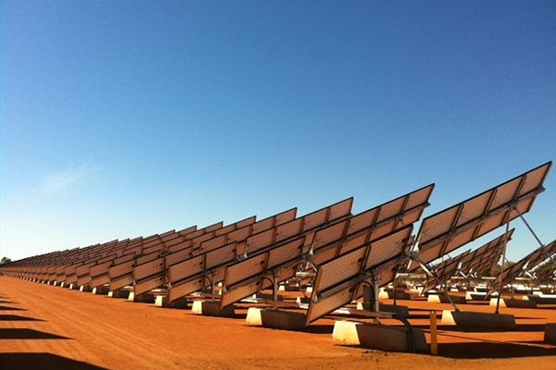
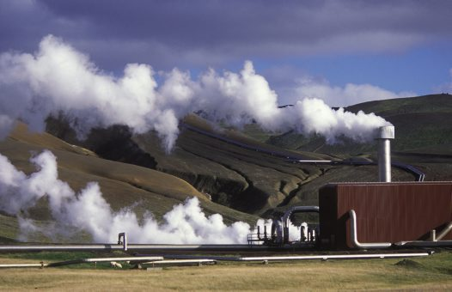
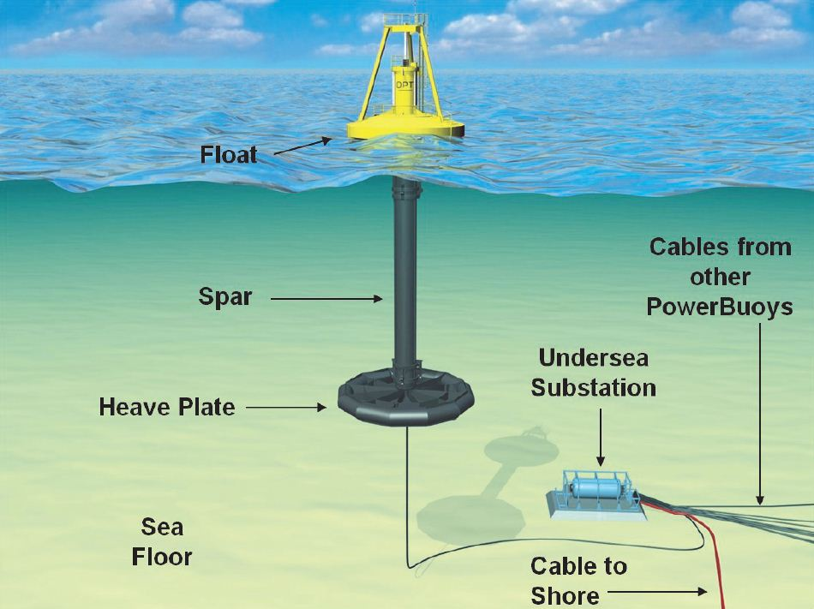

Slide 35
VI. Globalisation and Environmental Risks: Flows of Pollution
Political Issues
The public concern about the environment has seen the rise of a new political party, the Australian Green party.
In 2008, the Labor government proposed the “Carbon Pollution Reduction Scheme (CPRS) Bill” to cap industry’s use of coal and to encourage their use of renewable energies.
This proposal was opposed by the major opposition party, the Liberal and National Party, for imposing too many costs on industry. In contrast, the government’s proposal was also opposed by the Green Party, which wanted to impose a heavier carbon tax on industry.
The Federal and State governments continue to support research and development of sustainable, and less polluting, forms of energy.

Slide 36
Questions for Discussion
A. What is globalization? How is the concept generally defined?
B. What are the three major stages in Australia’s relationship with the outside world?
C. What are the dangers of building large-scale tourist developments in Australia? What is the concept of “Sustainable Tourism”?
D. What image of the world is reflected on Australian TV media? Why?
E. What impacts does climate change have on Australia?

Slide 37
The End
高等教育出版社
2015

